Slide 1
Vietnamese Food in Amsterdam CAPSTONE PROJECT
K Marchant
4 February 2021

Slide 2
1.0 Business Problem
After living in Amsterdam for several years, my perception was that there are relatively few Vietnamese restaurants.
The questions I would like to answer are:
How many Vietnamese restaurants are in Amsterdam and where are they located; and
Where would be a good location to establish a flagship Vietnamese restaurant in Amsterdam
Disclaimer: Before making an investment decision based on this analysis, forecasts that include the impact of COVID-19 should be considered.

Slide 3
2.0 Methodology
Collect Inspection Data
Explore and Understand the Data
Data preparation and preprocessing
Modeling
Evaluation and Testing

Slide 4
3.0 Collect Inspection Data
The list of data sources in the table below are intended to help answer the two questions in this analysis. That is:
How many Vietnamese restaurants are in Amsterdam and where are they located (source 1)
Where would be a good location to establish a flagship Vietnamese restaurant in Amsterdam (sources 2)
# | Data Description | Purpose
1 | Foursquare: Amsterdam restaurants by cuisine https://developer.foursquare.com/developer/ | Assess the number and location of Vietname restaurants in Amsterdam
2 | Gemeente Amsterdam: Data & Informatie https://data.amsterdam.nl/specials/dashboard/dashboard-kerncijfers/2b48132b-d877-40df-9c31-0bfc74f3ff54/ Population (Bevolking) File name: bbga_latest_and_greatest | Official population statistics are maintained by the local municipality, known locally as “de Gemeente”. This information can also be sourced from the Central Bureau of Statistics (Centraal Bureau voor de Statistiek)

Slide 5
3.1 Foursquare
The foursquare app will be used to locate the existing Vietnamese restaurants in Amsterdam, within a radius of 8000m from the city center.

Slide 6
3.2 Gemeente Amsterdam
# | Data Description | Field Names | English translation
1 | Gemeente Amsterdam: Data & Informatie https://data.amsterdam.nl/specials/dashboard/dashboard-kerncijfers/2b48132b-d877-40df-9c31-0bfc74f3ff54/ bbga_latest_and_greatest Original size of the data is circa 140MB. Reduction will need to occur prior to import /usage. | jaar gebiedcode15 variabele waarde | Year Area code Variable Value

Slide 7
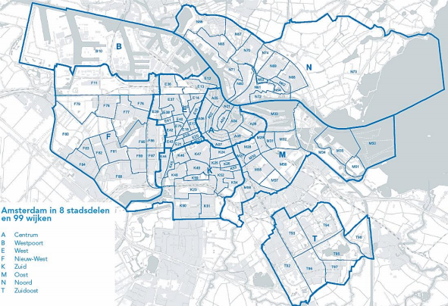
4.0 Explore and Understand the Data
This analysis will focus on the city of Amsterdam, located in the province of North Holland in the Netherlands. The 2020 population was 873,310 residents.
In the context of this analysis, it is important for the reader to understand is how the city of Amsterdam is split into various areas. This is relevant because this is how the data is structured and stored by the Central Bureau of Statistics and Amsterdam municipality.
Amsterdam is split into 8 districts (stadsdelen) and these districts are then further divided into a total of 99 neighbourhoods (wijken).
For example: The Zuidoost district (T) consists of T92, T93, T94, T95, T96, T97 and T98
Further information on the names of the neighbourhoods (wijken) can be found in Appendix 1.
Map of Amsterdam including its 8 stadsdelen en 99 wiken OIS (2019)

Slide 8
5.0 Pre-preparation and processing
Due to the significant size of the Gemeente Amsterdam: Data & Informatie data (140 MB), the following parameters were removed so that it could be processed:
Jaar / Year : 2005 to 2015
Gebiedcode15 | Area code: Buurten, Alternative buurten; and Rayons
Variabele | Variable: various non relevant parameters:
BEVBRIEF (letterbox address holders)
BEVINST (Institutes)
BEVVEST, BEVVERT, BEVVESTINT, BEVVERTINT, BEVGELUKINT, BEVMUTNL_P & BEVMUTTOT_P (additional details on people moving within in the Netherlands. This question asks did the resident change address from inside Amsterdam or come from another city/area in the Netherlands)
BEVPOTBBV (intention of the resident in terms of length of stay)
BEVSTERF (number of deaths) & BEVGEB (number of births)
Various household composition statistics (single, shared, family, family with children, other)

Slide 9
6.0 Modelling Approach
At a high level the modelling approach will make the following steps:
Identify the existing Vietnamese restaurants in Amsterdam
Identify the target demographic for our flagship Vietnamese restaurant, referring to data
Load, cleanse & enhance data sources (if required)
Identify the attributes of our target demographic in the data sources
Complete a clustering analysis for the identified attributes in Step 2 in our data

Slide 10
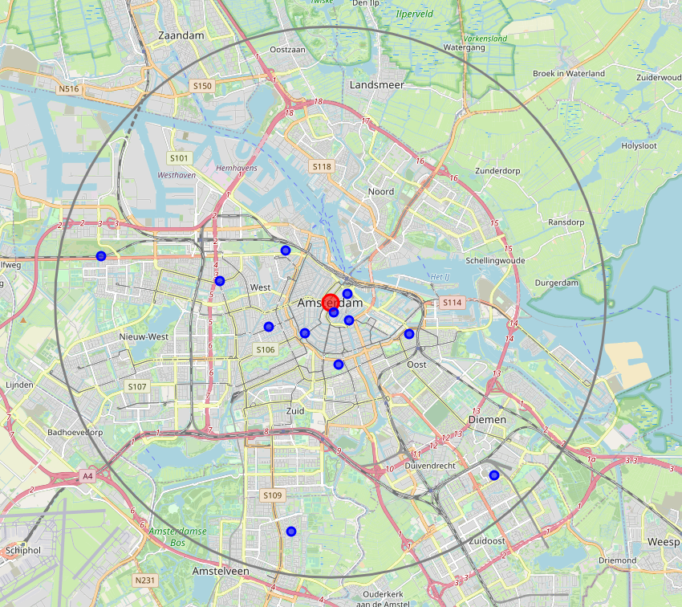
6.1 Foursquare: Current Vietnamese restaurants?
Utilizing the foursquare api and python tooling, I have identified the existing Vietnamese restaurants in Amsterdam.
In this call an 8000m radius (grey circle) was defined from the center of Amsterdam (red dot). This includes the main touristic and inner-city suburbs.

Slide 11
6.2 Target restaurant demographic
For the purposes of analysis, I will use the following two attributes in order to identify suitable locations, by Amsterdam neighbourhood (Wijken in Dutch).
Age group with highest restaurant spend; and
High income areas, on a relative basis

Slide 12
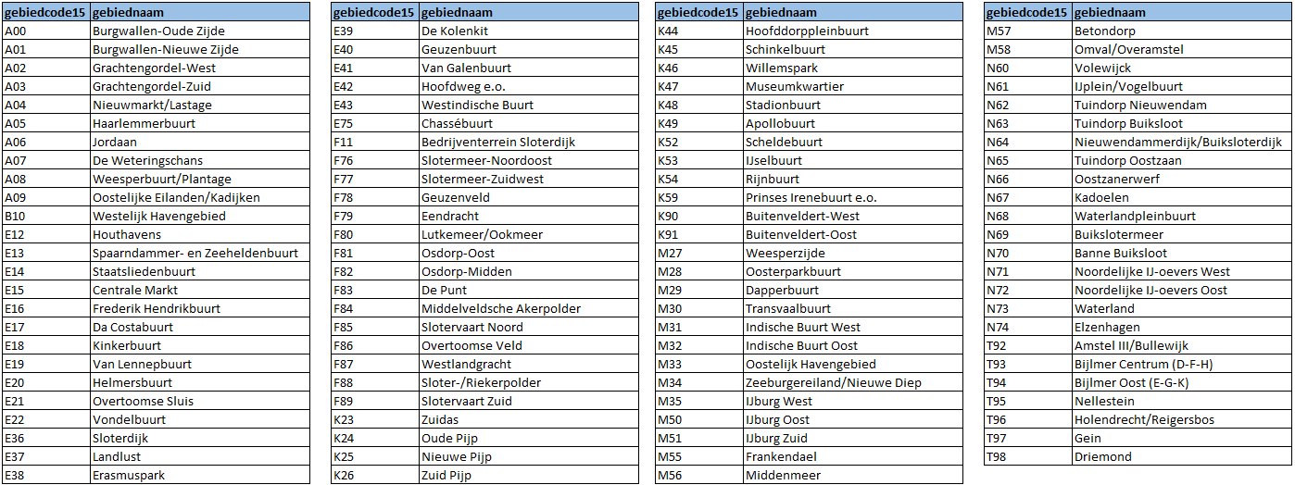
6.2.1 Neighborhoods (Wijken)
For the purposes of analysis, the data supports an evaluation at the level of the 99 neighbourhoods (Wijken in Dutch).

Slide 13
6.2.2 Age
Average household expenditure on food services Netherlands 2015. [S.Lock Nov 19, 2020]
Conclusion: this study shows the average household expenditure on food services in the Netherlands in 2015, by age of provider. The age group that spent the most on food services in 2015, was the 45 to 55 years age category with an expenditure amounting to 1,800 euros per year.
https://www.statista.com/statistics/762382/average-household-expenditure-on-food-services-in-the-netherlands-by-age-of-provider/
De Food-Track-Studie [University of Utrecht 2020]
Conclusion: This study identified the largest demographic for eating out (i..e restaurants & café’s) as 25-45 year old, non students
https://waareetjij.nu/het-onderzoek/
For the purposes of this analysis, I will focus on the 30 to 55 year old age group.
This appears to be feasible given our source data per neighbourhood (wijken)

Slide 14
6.2.3 Income
Income statistics are captured, on a lagging basis, with regards to the percentage of households with disposable income in the X quintile based on the national distribution of incomes.
Students and residents of institutes are not included in this statistic, which is ideal.
the 5th quintile are the highest earners and the 1st quintile the lowest. The sum of the 5 quartiles adds up to 100%
Conclusion: A good starting point to identify those with the highest disposable incomes is to use the neighbourhoods with the highest earners
For the purposes of this analysis, I will use the highest proportions in 5th quintile for income. This appears to be feasible given our source data per neighbourhood (wijken)

Slide 15
6.3 Load, cleanse and enhance data sources where required
Several fields contained null values, however by large the data was of a high standard ana able to be loaded successfully into the data frame.

Slide 16
6.4 Modelling Approach (1/2)
The 99 wijken in Amsterdam have diverse incomes and household compositions which provide a good representation of the different dimensions to this question.
Mapping the target demographic identified in 6.2 to our data, we will utilise the following attributes
Target Demographic | Data Source | Data Field | Data attribute
30 to 55 year old non student | 2 | Gemeente Amsterdam | variabele | BEV30_34 BEV35_39 BEV40_44 BEV45_50 BEV50_54
% of households with disposable income in the X quintile based on the national distribution of incomes. (highest proportion in 5th quintile) | 2 | Gemeente Amsterdam | variabele | IINKQ5_P

Slide 17
6.4 Modelling Approach (2/2)
The most complex part of the coding exercise in python was to create a dataframe using the groupby function:
Year (for example: 2018)
Wijken (for example: A00)
Sum of target age group in BEV30_34, BEV35_39, BEV40_44, BEV45_49, BEV50_54
Adding the IINKKQ5_P column to the dataframe to introduce the income dimension

Slide 18
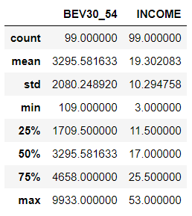
6.5 Scatterplot to identify target locations (1/2)
The data points of interest are at least one standard deviation from the mean
Age 30 to 55 year olds
3295 + 2080 = 5375
AND
% population in the 5th Quintle for household income (excluding students)
19.30+10.29 = 29.59

Slide 19
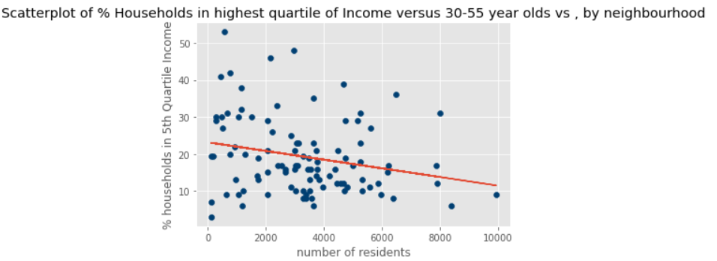
6.5 Scatterplot to identify target locations
Using the refined criteria we are left with two clear neighbourhoods in the top right hand segment:
M33 - Oostelijk Havengebied: 7988 residents, where 31% of the population are in the 5th Quintile for household income; and
M35 - IJburg West: 6485 residents, where 36% of the population are in the 5th Quintile for household income.

Slide 20
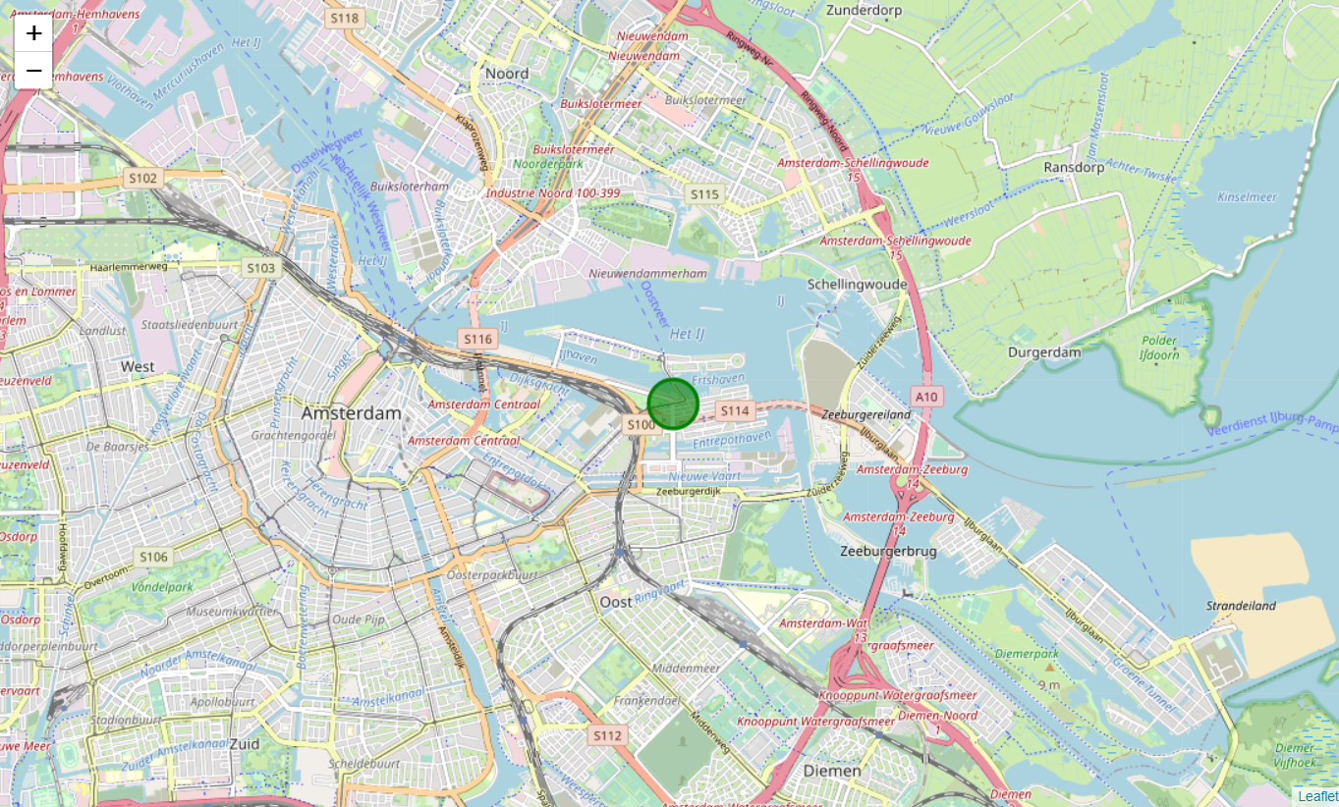
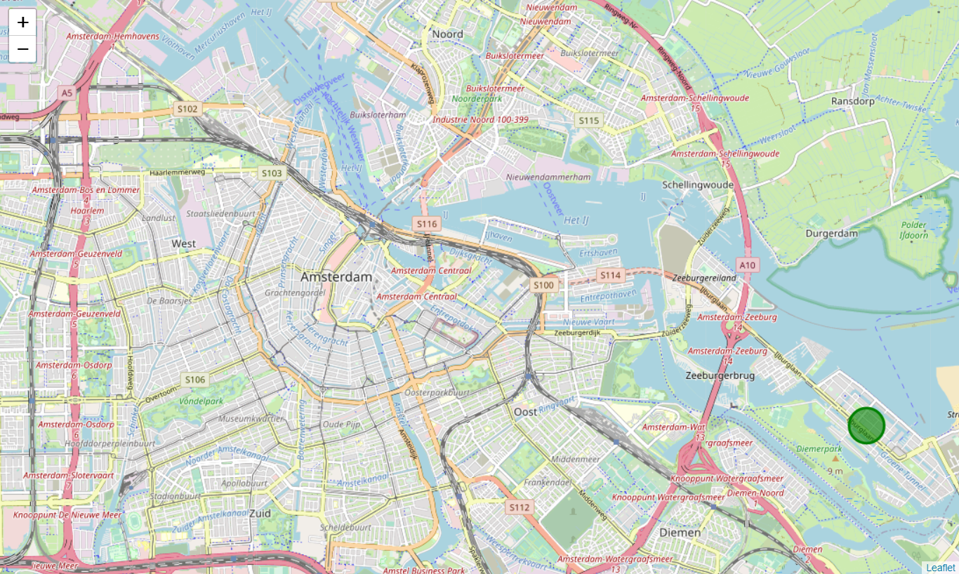
7.0 Conclusions
M33 - Oostelijk Havengebied: 7988 residents, where 31% of the population are in the 5th Quintile for household income
The following neighbourhoods (wijken) show good potential to open a flagship Vietnamese restaurant
M35 - IJburg West: 6485 residents, where 36% of the population are in the 5th Quintile for household income.

Slide 21
7.0 Final Notes
The two identified locations are a good starting point for further analysis, however additional considerations include:
Supply & suitability of available restaurant locations;
Cost considerations in terms of the cost per m2; and
Future infrastructure projects and urban planning developments.

Slide 22
Appendix
1. Data sources: Gemeente Amsterdam

Slide 23
Appendix 1: Gemeente Amsterdam | Year
# | Data | Data Name | Data Description
1.1 | jaar [year] | jaar | Four digit numeric reference to the calendar year |”2020”
Due to the significant size of the source data file, the years 2005 to 2015 were removed

Slide 24
Appendix 1: Gemeente Amsterdam | Geography
# | Data | Data Name | Data Description
1.2 | gebiedcode15 [area code] | Stadsdelen | City Districts – 8 areas + other | single alpha character | “A”
 |  | 22 gebieden | Sub districts - 22 areas | DX+2 numeric characters |”DX01”
 |  | Wijken | Neighbourhoods – 99 | single alpha + 2 numeric characters | “A01”
 |  | Postcodes | Geogrpahic grouping|four digit numeric number |”1076”
 |  | Buurten Alternatieve buurten Rayons | Sub sections of wijken | addition of single alpha character | ”A01a” Reclassfication of Buurten | 2 alpha + 2 numeric | “AS01” 89 areas linked to 22 gebieden | bb+numeric | “bb1”
Due to the significant size of the source data file and the required focus for this analysis all but the “Wijken” (99 neighborhoods) were removed.

Slide 25
Appendix 1: Gemeente Amsterdam | Variables (1 of 2)
# | Data | Data Name | Data Description
1.3 | variabele [variable] | BEVTOTAAL | Number of persons who are included in the population register of the municipality of Amsterdam on 1 January
 |  | BEVMAN | Number of men on 1 January of the reference year
 |  | BEVVROUW | Number of women on 1 January of the reference year
 |  | BEVDICHT | Number of residents per square kilometer of land
 |  | BEVANTIL, BEVTURK, BEVMAROK, BEVOVNW, BEVWEST, BEVAUTOCH | Number of Amsterdammers born [or whose parents were born) in: (a) the former Netherlands Antilles; (b) Turkey; (c) Morocco; (d) non western; (e) western; or (f) no migration information
 |  | BEVNSTEDELING | Number of people with a Dutch or Western migration background (excluding Eastern Europe), aged 18 to 54, registered after their 18th birthday in Amsterdam.
 |  | BEVOPLLAAG, BEVOPLMID, BEVOPLHOOG | Proportion (%) of low, middle and high educated residents of the population aged 15 to 74
 |  | BEVX_Y | Persons aged “X” to “Y” who are registered in the municipality of Amsterdam on the reference date. For example BEV25_29 = number of persons aged between 25 and 29
 |  | IINKQX_P | Percentage of households with disposable income in the X quintile based on the national distribution of incomes. Students and residents of institutes are not included (5th Quintile is the highest earners)

